Slide 1
Introduction to Network Monitoring PowerPoint
ISM4220C
Professor: Cheryl Schmidt
Creator: Joslen Tardncilla
September 7, 2024

Slide 2

Exploring the Concept of IT Systems Monitoring
Definition: Monitoring is the continuous process of analyzing data, from different parts of a system to detect and predict issues.
Purpose: By taking heed of warnings and staying proactive in maintenance tasks, this ensures that operations run smoothly and efficiently while minimizing disruptions and potential breakdowns.
Important Elements to understand: Alerts (notifications, for problems) Events (actions taken by the system) Logs ( records) Metrics (performance measurements) and Dashboards (visual summaries).
Ensuring a connection to interests is also important. This manages networks effectively and maintains the security and performance standards of cloud services and IT systems.
Example: Monitoring is used in network management applications utilized to pinpoint traffic patterns that could indicate potential security breaches or declines in performance quality.

Slide 3
Fictitious scenario. The importance of analyzing logs (Part 1).
Scenario: A bank is facing an increase in transaction errors and delays that could affect customer transactions.
Role of IT in monitoring: As an IT administrator you must identify the underlying issue by examining the stored logs (root cause analysis)
Examining Logs;. Review logs from servers, firewalls, and databases to detect patterns. Such as recurring unsuccessful transactions or unexpected access efforts.
Discovery: The investigation reveals a server process that is resulting in database lock errors and consequently causing delays, in transaction processing. Further inspection shows that this server is misconfigured.
Action: Task at hand involves adjusting the server configs to rectify any issues that are causing errors and bringing back the transaction speeds to their correct levels.

Slide 4
Fictitious Scenario, Dashboard Data Analysis (Part 2).
After solving the problem at hand‚ the administrator checks the systems performance using a dashboard to track it in time.
Dashboard Functionality: Monitoring statistics; such as response times, error rates. and server capacity to maintain system stability.
Visual Insights: This provides a way to showcase trends and Swiftly pinpoints any common issues or peak traffic periods.
Quick Response actions: This allows the administrator to quickly identify and deal with any problems as they arise.
The outcome: Prevents interruptions through the implementation of decisions based on data and the maintenance of ongoing performance monitoring.

Slide 5
The comparison of Proactive and Reactive monitoring
Proactive Monitoring involves detecting problems early on and predicting potential issues through observing data. Examples of this would be increased CPU usage or low disk space and sending alerts in advance of failures for timely preventive measures.
Reactive Monitoring: This involves addressing events once they occur. For example, handling a server crash or application downtime by responding to alerts when a serious issue is identified.
Contrast of each approach: proactive monitoring aims to stop problems before they happen while reactive monitoring deals with them post occurrence.
By utilizing both approaches you guarantee seamless system functionality and swift recuperation from any issues that may arise.

Slide 6
Examples that go beyond the reading
Notifications and alerts: An alert sent out when the CPU temperature of a server goes beyond 70 degrees Celsius to avoid any damage from overheating issues. Another example of an alert would be when there is unusually high memory usage or spikes in bandwidth.
Events: Instances such as daily backups that are recorded for verification of successful execution. Also, security scans signaling any abnormal activities producing logs of events.
Logging: An example of logging would be keeping a record of all adjustments made to firewall configurations to maintain compliance and enhance security measures. These logs Track every instance of user interaction, with confidential information to uphold policy requirements effectively.

Slide 7
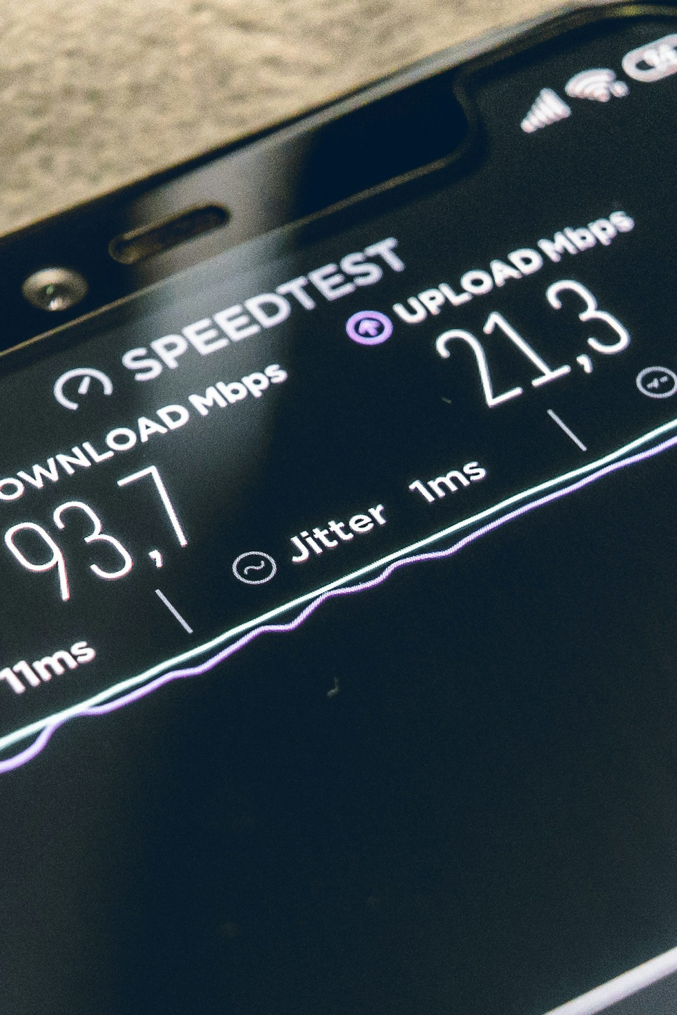
Metric 1: focusing on the usage of network devices.
Metric: packet loss percentage. When we talk about "Packet Loss Percentage " we're referring to the rate at which data packets don't successfully reach their intended destination on a network.
This is Suitable for use in devices such as routers and switches that require communication.
Alert threshold: When the packet loss goes beyond 2% an alert is triggered indicating issues such as network congestion or hardware failure potentially caused by cyber threats.
Impact Explanation: Excessive packet loss can seriously harm network performance by causing delays in service delivery and interruptions to user connections – leading to frustration among users. Immediate intervention is crucial to revive the quality of service provided.

Slide 8
Metric 2: Server resource util
Metric: "Disk I/O Wait”. This metric monitors the duration processes spend waiting for disk access and can signal the presence of bottlenecks.
Application: Suitable for servers and storage systems that experience data read and write activities in busy settings.
Threshold: The alert is activated when the disk I/O wait time surpasses 100 milliseconds as a sign that the system might be overwhelmed or operating inefficiently.
The impact: Prolonged periods of waiting times can delay the processing of applications and lead to slower response rates and potential service disruptions that may impact user satisfaction and operational efficiency.

Slide 9

Availability Calc for a Fictitious System
System: An online shopping platform needs to be accessible around the clock for customers from over the world.
Uptime: The system has been operational for a total of 720 hours, within a month spanning 30 days.
Downtime Scenario: During downtimes we account for 2 hours for scheduled server maintenance tasks, 3 hours due to network failures, and an hour for software updates.
Total downtime: Combined downtime lasted for 6 hours due to a mix of scheduled maintenance and unexpected interruptions.
Calculations: The availability calculation shows that the system was up and running 99..17 percent of the time with little downtime. Availability percentage = (720 - 6) / 720 = 99.17%.
Interpreting the calc: Maintaining a level of availability (99​ ​percent) is essential, for upholding user confidence and customer happiness while also reducing the potential financial impact of system downtime.

Slide 10

Overview of Amazon CloudWatch.
Overview: The AWS service is created to monitor resources and applications in both cloud and on premises environments.
Operations: Operations include gathering and retaining logs while also establishing alerts and displaying data in a visual format to better understand performance metrics and automate reactions as necessary to fulfill operational requirements.
Notifications and Alarms: These can be configured by establishing limits for metrics (such, as CPU usage or response time) triggering automated alerts or responses.
Integration: Integration is smooth as it works well with AWS services such as SNS for messaging and EventBridge, for event driven automation.
Benefits: Pros include consolidating monitoring tasks, for problem solving and ensuring optimal system uptime and dependability.

